Slide 1

Daily Routine Infographics
Here is where your presentation begins

Slide 2
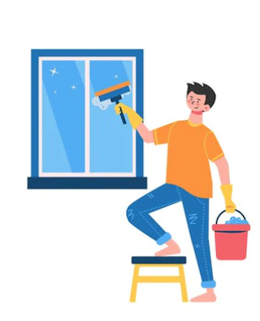
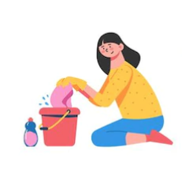
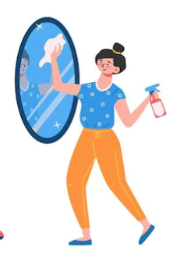

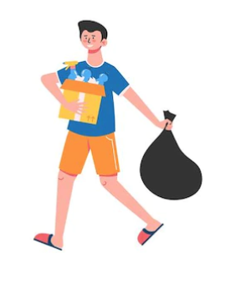
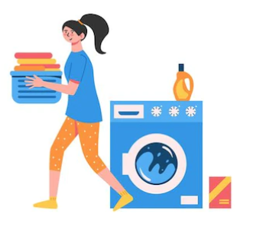
Daily Routine Infographics
Earth
Mercury
01
Earth is the third planet from the Sun
Mercury is the closest planet to the Sun
04
Neptune
Mars
02
Neptune is the farthest planet from the Sun
Despite being red,
Mars is a cold place
05
Saturn
Jupiter
03
Saturn is composed of hydrogen and helium
Jupiter is the biggest planet of our System
06

Slide 3

Daily Routine Infographics
Earth
Neptune
Saturn
Mars
Mercury
Earth is the third planet from the Sun
Neptune is the farthest planet from the Sun
It’s composed of hydrogen and helium
Despite being red, Mars is a cold place
Mercury is the closest planet to the Sun

Slide 4

Daily Routine Infographics
Saturn
Saturn is composed of hydrogen and helium
Mars
Despite being red, Mars is a cold place
Mercury
Mercury is the closest planet to the Sun
Jupiter
Jupiter is the biggest planet of our System
Neptune
Neptune is the farthest planet from the Sun

Slide 5
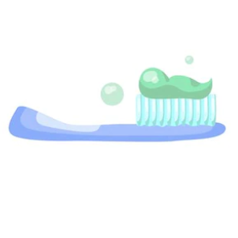
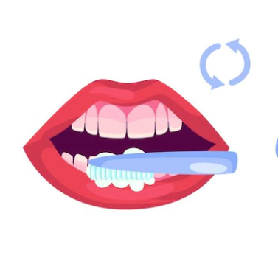
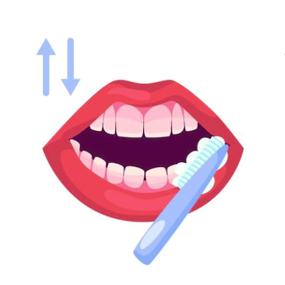
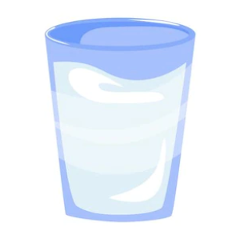

Daily Routine Infographics
Work
Lunch
Wash dishes
Clean up
Bath
Earth is the third planet from the Sun
Neptune is the farthest planet from the Sun
It’s composed of hydrogen and helium
Despite being red, Mars is a cold place
Mercury is the closest planet to the Sun

Slide 6

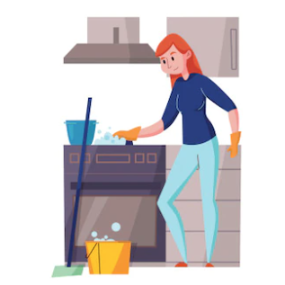
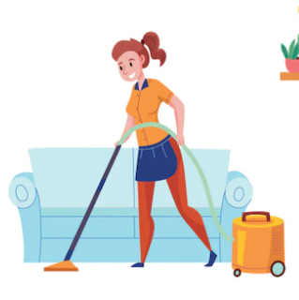
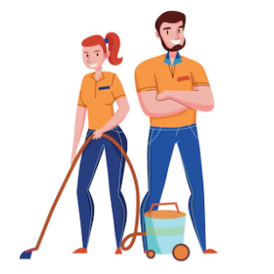
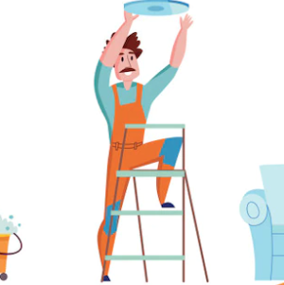
Daily Routine Infographics
Earth
Neptune
Saturn
Mars
Mercury
Earth is the third planet from the Sun
Neptune is the farthest planet from the Sun
It’s composed of hydrogen and helium
Despite being red, Mars is a cold place
Mercury is the closest planet to the Sun

Slide 7
Daily Routine Infographics
Routine | tips | Check
Morning routine | Bath
 | Breakfast
Work | Plan your meetings
 | Projects
Free time | Meditate
 | Yoga

Slide 8
Daily Routine Infographics
Mars
10%
Mars despite being red, Mars is actually a very cold place
Jupiter
45%
Jupiter is a gas giant and the biggest planet of the Solar System
Mercury
45%
Mercury is the closest planet to the Sun and the smallest one
Follow the link in the graph to modify its data and then paste the new one here. For more info, click here

Slide 9
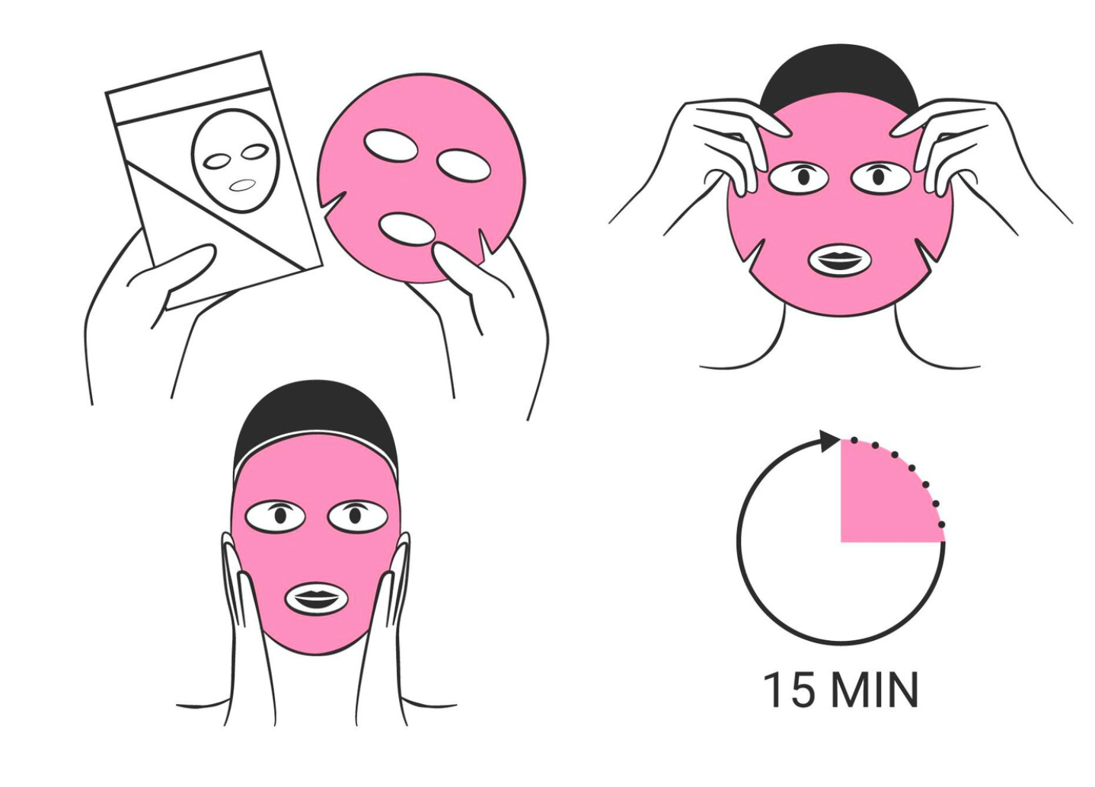
Daily Routine Infographics
Skin care daily routine
Saturn
Neptune
It’s composed of hydrogen and helium gas
Neptune is the farthest planet from the Sun
Jupiter
Mercury
Jupiter is the biggest planet in the Solar System
Mercury is the closest planet to the Sun

Slide 10
Daily Routine Infographics
Track your activities
Work
01
Earth is the third planet from the Sun
45%
Study
02
Neptune is the farthest planet from the Sun
25%
Cook
03
Mercury is the closest planet to the Sun
30%

Slide 11
Daily Routine Infographics
April 2021
Sunday | Monday | Tuesday | Wednesday | Thursday | Friday | Saturday | TO DO
 |  |  |  |  | 01 | 02 | Study
03 | 04 | 05 | 06 | 07 | 08 | 09 | Lunch
10 | 11 | 12 | 13 | 14 | 15 | 16 | Lessons
17 | 18 | 19 | 20 | 21 | 22 | 23 | Project
24 | 25 | 26 | 27 | 28 | 29 | 30 | Yoga
31 |  |  |  |  |  |  | Medite

Slide 12
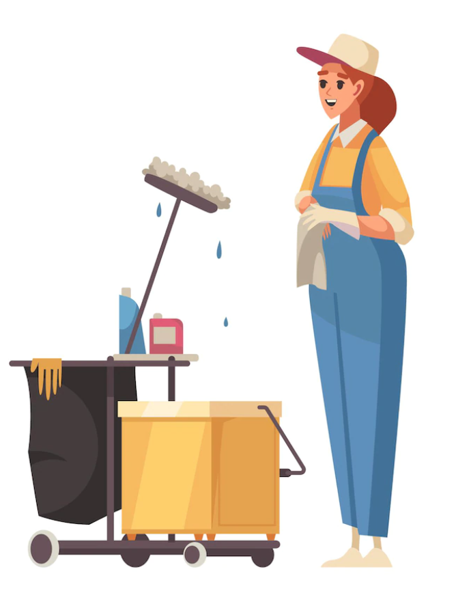
Daily Routine Infographics
Organize your day at work
Write a list
Earth is the third planet from the Sun
01
Plan your meetings
Neptune is the farthest planet from the Sun
02
Don't forget the break
Saturn is composed of hydrogen and helium
03

Slide 13
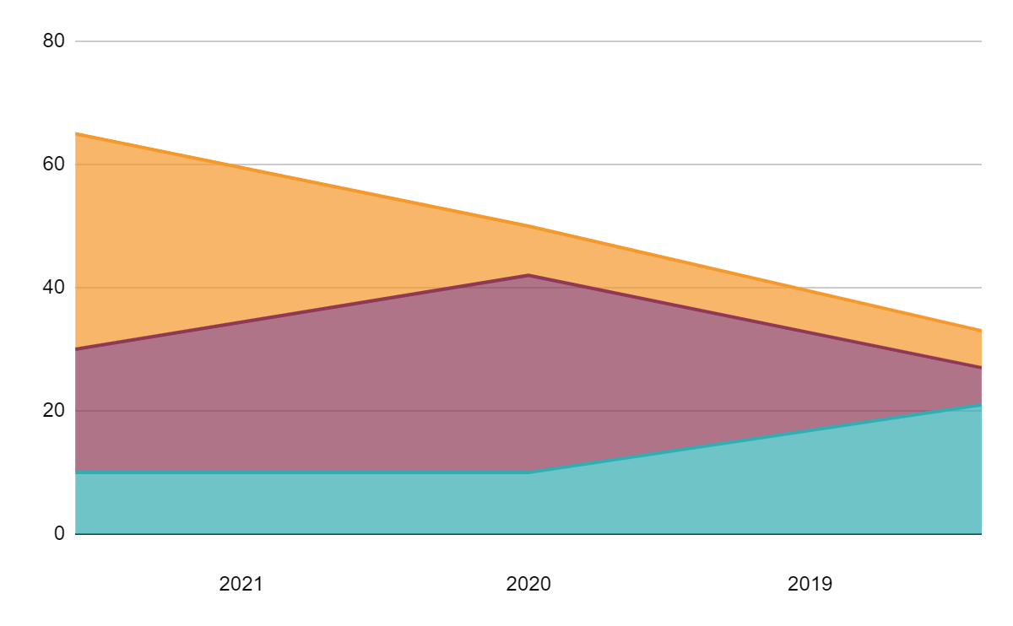
Daily Routine Infographics
Earth
Earth is the third planet from the Sun
Neptune
Neptune is the farthest planet from the Sun
Mercury
Follow the link in the graph to modify its data and then paste the new one here. For more info, click here
Mercury is the closest planet to the Sun

Slide 14

Daily Routine Infographics
Morning routine
Earth
Earth is the third planet from the Sun
Neptune
Neptune is the farthest planet from the Sun
Mercury
Mercury is the closest planet to the Sun

Slide 15
Daily Routine Infographics
Neptune
70%
Neptune is the farthest planet from the Sun
Mars
10%
Despite being red,
Mars is a cold place
Saturn
30%
It’s composed of hydrogen and helium

Slide 16

Daily Routine Infographics
Night routine
Earth
Earth is the third planet from the Sun
Neptune
Neptune is the farthest planet from the Sun
Saturn
Saturn is composed of hydrogen and helium

Slide 17
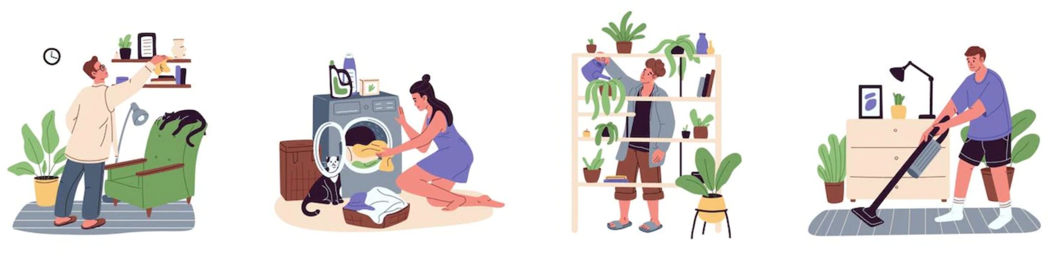
Daily Routine Infographics
Neptune
Mercury
Neptune is the farthest planet from the Sun
Mercury is the closest planet to the Sun
01
03
02
04
Go for a walk
Saturn
Earth
Planet Mercury is the closest object to the Sun
Saturn is composed of hydrogen and helium
Earth is the third planet from the Sun

Slide 18
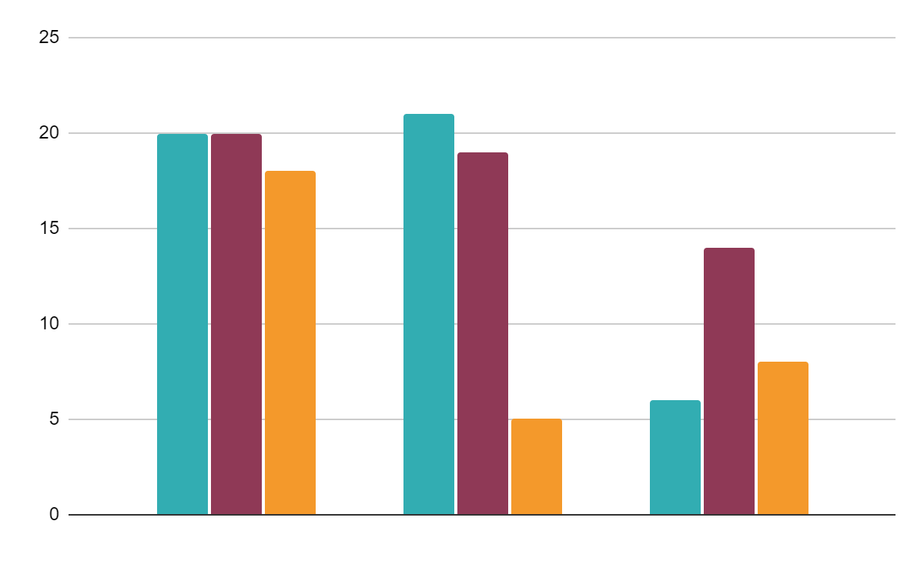
Daily Routine Infographics
Saturn
01
Saturn is composed of hydrogen and helium
Mars
02
Despite being red, Mars is a cold place
Jupiter
Week 1
Week 2
Week 3
03
Follow the link in the graph to modify its data and then paste the new one here. For more info, click here
It’s a gas giant and the biggest planet of them all

Slide 19

Daily Routine Infographics
45K
Saturn
C
Saturn is composed of hydrogen and helium gas
56K
Mercury
B
It’s the closest planet to the Sun and the smallest one
10K
Mars
C
Despite being red, Mars is actually a very cold place

Slide 20
Daily Routine Infographics
Wake up
Meeting
It’s the third planet from the Sun
Despite being red,
Mars is a cold place
07:00
09:00
11:00
13:00
Check-in
Lunch
It’s the farthest planet from the Sun
It’s the closest planet to the Sun

Slide 21
Daily Routine Infographics
Time | Routine
8:00 | Meditate
9:00 | Yoga
10:00 | Planning
11:00 | Work
12:00 | Conference
13:00 | Meeting
Time | Routine
14:00 | Lunch
15:00 | Coffee
16:00 | Relax
17:00 | Sport & stretch
18:00 | Bath
19:00 | Skin care

